Slide 1
In-Class Practical
Write a C# program that copies the contents of a two-dimensional array into a one-dimensional array.
A | C | E | G
B | D | F | H
A | B | C | D | E | F | G | H
Notes:
Because there is some variability in what you might have learned already, I need a chance to watch you code.
That happens now.

Slide 2
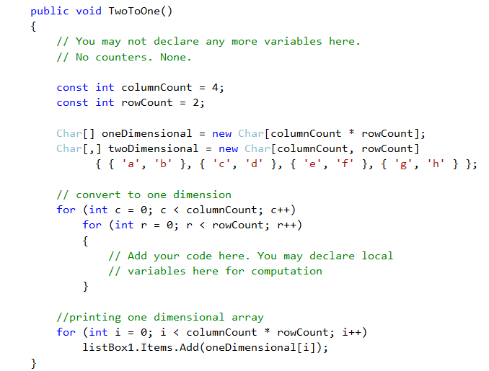
In-Class Practical
Notes:
You must start with this (text file available on I:drive, or type it in)
Write this method and call it in a button click handler on the form.
NB: You may only declare new variables local to the nested for. You may not declare any kind of counter.
We will spend exactly 20 minutes on this – if you don’t finish it in that time, then you’ll just stop. I will walk around and see how things are going.
No discussion, please. This is an individual exercise.

Slide 3
Task 1 – Class Design
Before next session (mandatory)
Bridge Dealing Application:
A bridge deal comprises four hands (N,S,E,W), each made up of 13 cards
The quality of a bridge hand is measured by counting its High Card Points
A = 4
K = 3
Q = 2
J = 1

Slide 4
Task 1 – Class Design
Design a class architecture for a Bridge Dealing program that deals out four hands and displays them (textually), sorted into suits, along with the HCP for each hand.
Draw a UML-style diagram of your classes, showing class name, properties and methods for all classes.
Pseudo-code your methods.
Bring your class diagram and pseudo-code (hard copy; hand-written is fine) to class for Session 2
Notes:
Don’t implement, just write the documents. This practical is marked on the documents.
Think especially carefully about the core OO principles while designing your classes.
Look especially for coupling – does any class know more about the implementation details of any other class than is absolutely necessary?

